Slide 1

Intro to VIM
By Jun Ren | P2P Backend

Slide 2

Introduction to VIM
VIM Basics
Customizing VIM
Resources

Slide 3

What is VIM
Highly customizable text editor
Designed for effective text manipulation

Slide 4
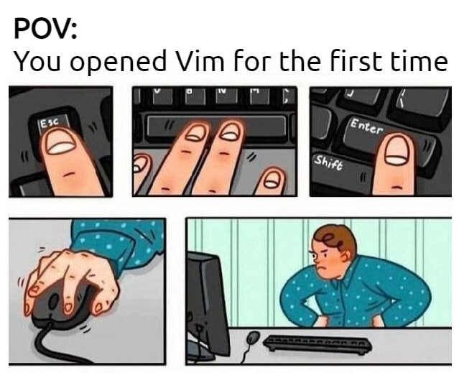
Why learn VIM
Extensibility and customizability
Transferrable skill
Improves your productivity

Slide 5
VIM BASICS

Slide 6
VIM Modes
i
Insert
Typing text
:
Normal
Command
Navigation / Text manipulation
Entering commands
v
Visual
Highlighting text

Slide 7
VIM Modes
i
Insert
Typing text
:
Normal
Command
Navigation / Text manipulation
Entering commands
v
Visual
Highlighting text

Slide 8
VIM Modes
i
Insert
Typing text
:
Normal
Command
Navigation / Text manipulation
Entering commands
v
Visual
Highlighting text

Slide 9
VIM Modes
i
Insert
Typing text
:
Normal
Command
Navigation / Text manipulation
Entering commands
v
Visual
Highlighting text

Slide 10

VIM Commands
Syntax: Operator (Verb) + Motion (Noun)
Operators define the action to take
Motions define the scope of the action
Example: ‘d’ for delete + ‘w’ for word
‘dw’ = delete word
‘3dw’ = delete 3 words
Notes:
-

Slide 11
VIM Operators (Verbs)
d | Delete
c | Change (delete and go into insert mode)
v | Visually select
> / < | Indent
y | Yank

Slide 12
VIM Operators (Verbs)
d | Delete
c | Change (delete and go into insert mode)
v | Visually select
> / < | Indent
y | Yank

Slide 13
VIM Operators (Verbs)
d | Delete
c | Change (delete and go into insert mode)
v | Visually select
> / < | Indent
y | Yank

Slide 14
VIM Operators (Verbs)
d | Delete
c | Change (delete and go into insert mode)
v | Visually select
> / < | Indent
y | Yank

Slide 15
VIM Operators (Verbs)
d | Delete
c | Change (delete and go into insert mode)
v | Visually select
> / < | Indent
y | Yank

Slide 16
VIM Motions (Nouns)
h, j, k, l | Move the cursor left, down, up, or right by one character
w, b, e | Move the cursor to the next word, previous word, or end of the current word
0, $ | Move the cursor to the beginning or end of the current line
gg, G | Move the cursor to the beginning or end of the file
{ , } | Moves the cursor forward to the beginning of the previous, next paragraph
% | Moves the cursor to the matching parenthesis, brace, or bracket
f/t | Moves the cursor to (f) or just before (t) the next occurrence of a specified character in the current line

Slide 17
VIM Motions (Nouns)
h, j, k, l | Move the cursor left, down, up, or right by one character
w, b, e | Move the cursor to the next word, previous word, or end of the current word
0, $ | Move the cursor to the beginning or end of the current line
gg, G | Move the cursor to the beginning or end of the file
{ , } | Moves the cursor forward to the beginning of the previous, next paragraph
% | Moves the cursor to the matching parenthesis, brace, or bracket
f/t | Moves the cursor to (f) or just before (t) the next occurrence of a specified character in the current line

Slide 18
VIM Motions (Nouns)
h, j, k, l | Move the cursor left, down, up, or right by one character
w, b, e | Move the cursor to the next word, previous word, or end of the current word
0, $ | Move the cursor to the beginning or end of the current line
gg, G | Move the cursor to the beginning or end of the file
{ , } | Moves the cursor forward to the beginning of the previous, next paragraph
% | Moves the cursor to the matching parenthesis, brace, or bracket
f/t | Moves the cursor to (f) or just before (t) the next occurrence of a specified character in the current line

Slide 19
VIM Motions (Nouns)
h, j, k, l | Move the cursor left, down, up, or right by one character
w, b, e | Move the cursor to the next word, previous word, or end of the current word
0, $ | Move the cursor to the beginning or end of the current line
gg, G | Move the cursor to the beginning or end of the file
{ , } | Moves the cursor forward to the beginning of the previous, next paragraph
% | Moves the cursor to the matching parenthesis, brace, or bracket
f/t | Moves the cursor to (f) or just before (t) the next occurrence of a specified character in the current line

Slide 20
VIM Motions (Nouns)
h, j, k, l | Move the cursor left, down, up, or right by one character
w, b, e | Move the cursor to the next word, previous word, or end of the current word
0, $ | Move the cursor to the beginning or end of the current line
gg, G | Move the cursor to the beginning or end of the file
{ , } | Moves the cursor forward to the beginning of the previous, next paragraph
% | Moves the cursor to the matching parenthesis, brace, or bracket
f/t | Moves the cursor to (f) or just before (t) the next occurrence of a specified character in the current line

Slide 21
VIM Motions (Nouns)
h, j, k, l | Move the cursor left, down, up, or right by one character
w, b, e | Move the cursor to the next word, previous word, or end of the current word
0, $ | Move the cursor to the beginning or end of the current line
gg, G | Move the cursor to the beginning or end of the file
{ , } | Moves the cursor forward to the beginning of the previous, next paragraph
% | Moves the cursor to the matching parenthesis, brace, or bracket
f/t | Moves the cursor to (f) or just before (t) the next occurrence of a specified character in the current line

Slide 22
VIM Motions (Nouns)
h, j, k, l | Move the cursor left, down, up, or right by one character
w, b, e | Move the cursor to the next word, previous word, or end of the current word
0, $ | Move the cursor to the beginning or end of the current line
gg, G | Move the cursor to the beginning or end of the file
{ , } | Moves the cursor forward to the beginning of the previous, next paragraph
% | Moves the cursor to the matching parenthesis, brace, or bracket
f/t | Moves the cursor to (f) or just before (t) the next occurrence of a specified character in the current line

Slide 23
Undo / Redo / Repeat
u | Undo last command
CTRL + R | Redoing last command
. | Repeating last command

Slide 24
Undo / Redo / Repeat
u | Undo last command
CTRL + R | Redoing last command
. | Repeating last command

Slide 25
Undo / Redo / Repeat
u | Undo last command
CTRL + R | Redoing last command
. | Repeating last command

Slide 26

Insert mode
i | Enters insert mode before the current cursor position
O | Enters insert mode one live above
o | Enters insert mode one line below
a | Enters insert mode after moving 1 character to the right
A | Enters insert mode at the end of the current line
R | Enters replace mode

Slide 27

Navigating (Screen)
zt, zz, zb | Scrolls the screen so that the current line is at the top, center, or bottom, respectively
CTRL-f or CTRL-b | Scrolls the screen forward or backward by a full page.
CTRL-d or CTRL-u | Scrolls the screen forward or backward by half a page

Slide 28
Navigating (Screen)
zt, zz, zb | Scrolls the screen so that the current line is at the top, center, or bottom, respectively
CTRL-f or CTRL-b | Scrolls the screen forward or backward by a full page.
CTRL-d or CTRL-u | Scrolls the screen forward or backward by half a page

Slide 29
Navigating (Screen)
zt, zz, zb | Scrolls the screen so that the current line is at the top, center, or bottom, respectively
CTRL-f or CTRL-b | Scrolls the screen forward or backward by a full page.
CTRL-d or CTRL-u | Scrolls the screen forward or backward by half a page

Slide 30

Navigating (Jumplist / Marks)
Ctrl + o / i | Go to [o]lder / newer position in jump list
m + {lower_case_register} / {UPPER_CASE_REGISTER} | (‘m’ + ‘a’) Mark current position in a (local) (‘m’ + ‘A’) Mark current position in A (global)
' + {mark} | Jump to mark

Slide 31
Navigating (Jumplist / Marks)
Ctrl + o / i | Go to [o]lder / newer position in jump list
m + {lower_case_register} / {UPPER_CASE_REGISTER} | (‘m’ + ‘a’) Mark current position in a (local) (‘m’ + ‘A’) Mark current position in A (global)
' + {mark} | Jump to mark

Slide 32
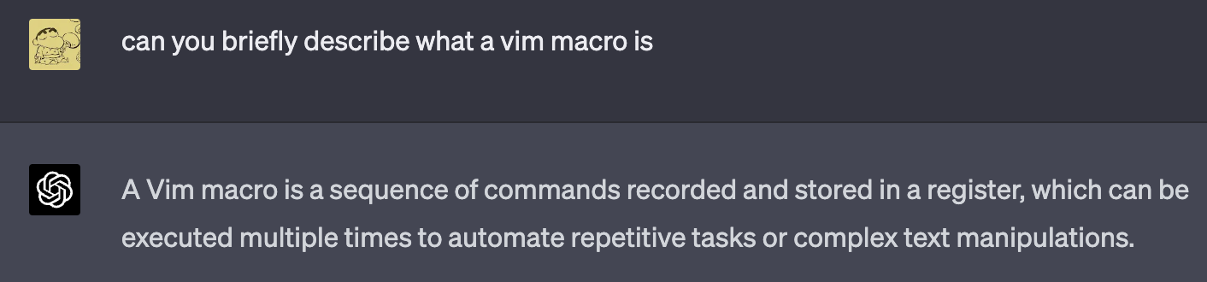
Macros
Begin recording with ‘q’
Choose a register
Edit however you want
End recording with q
Apply macro to lines (there are many ways) e.g.
:5,$norm! @a (Apply macro on line 5 till end of file)

Slide 33

Customizing VIM
Configuration file
/.ideavimrc
Key bindings / mappings
Plugins
Notes:
General info about dot files
Share some useful key mappings
Share some useful plugins (like surround)

Slide 34


Resources
YouTube (Primagen, DevOps Toolbox etc.)
VIM plugins https://github.com/akrawchyk/awesome-vim
VIM cheat sheet https://vim.rtorr.com/
Partly adapted from https://ctoomey.com/mastering-the-vim-language-slides.pdf
@Evan Tan 陈俊融

Slide 35
Summary
VIM Modes
Text manipulation commands
Navigation commands
Configuring VIM plugins / key mappings
Notes:
General info about dot files
Share some useful key mappings
Share some useful plugins (like surround)

Slide 36

Thank you for listening
stonks

